Slide 1
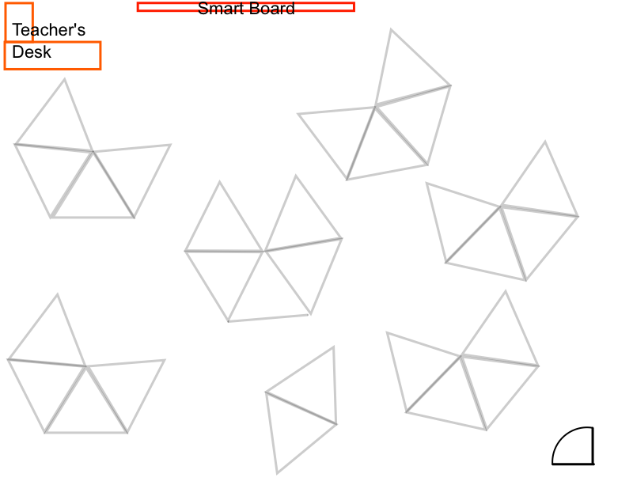
Luis
Christopher
Nichole
Leslye
Diego
Ruben
Josh
Kalani
Michael
Oasis
Avery
Lucas
Brent
Julian
Emiliano
Edgar
Amal
Melanie
Eli
Ben
Jean
Mariam
Eliut
Eric
Jean

Slide 2
Image Functions
What do we need to know to write image functions in Racket?

Slide 3
parts of a function
name
arguments
(circle 50 "solid" "red")

Slide 4
contracts (API)
(circle radius mode color)
; circle : number string string -> image
name domain range

